Slide 1


Hotel Reservation Cancelation Prediction
Burak Arslan

Slide 2

Introduction
Motivation :
As Hotel we will overbook once we know our safe margin.
Objective :
Try to predict the ones who will cancel reservations ?
Goals :
Try to find best algorithm and predict the which reservations will be canceled.

Slide 3









Methodology
Data :
Hotel booking demand datasets : Kaggle
Tools :
Database : Postgresql
Data Cleaning : pandas, numpy
Visualizations : matplotlib, seaborn
ML : sklearn, K-fold
Development Environment : Jupyter
Roadmap
Data Fetch & Clean (Postgresql -> dataframe )
Eda
Feature Engineering
Model Selection with K-Fold
Model tuning

Slide 4
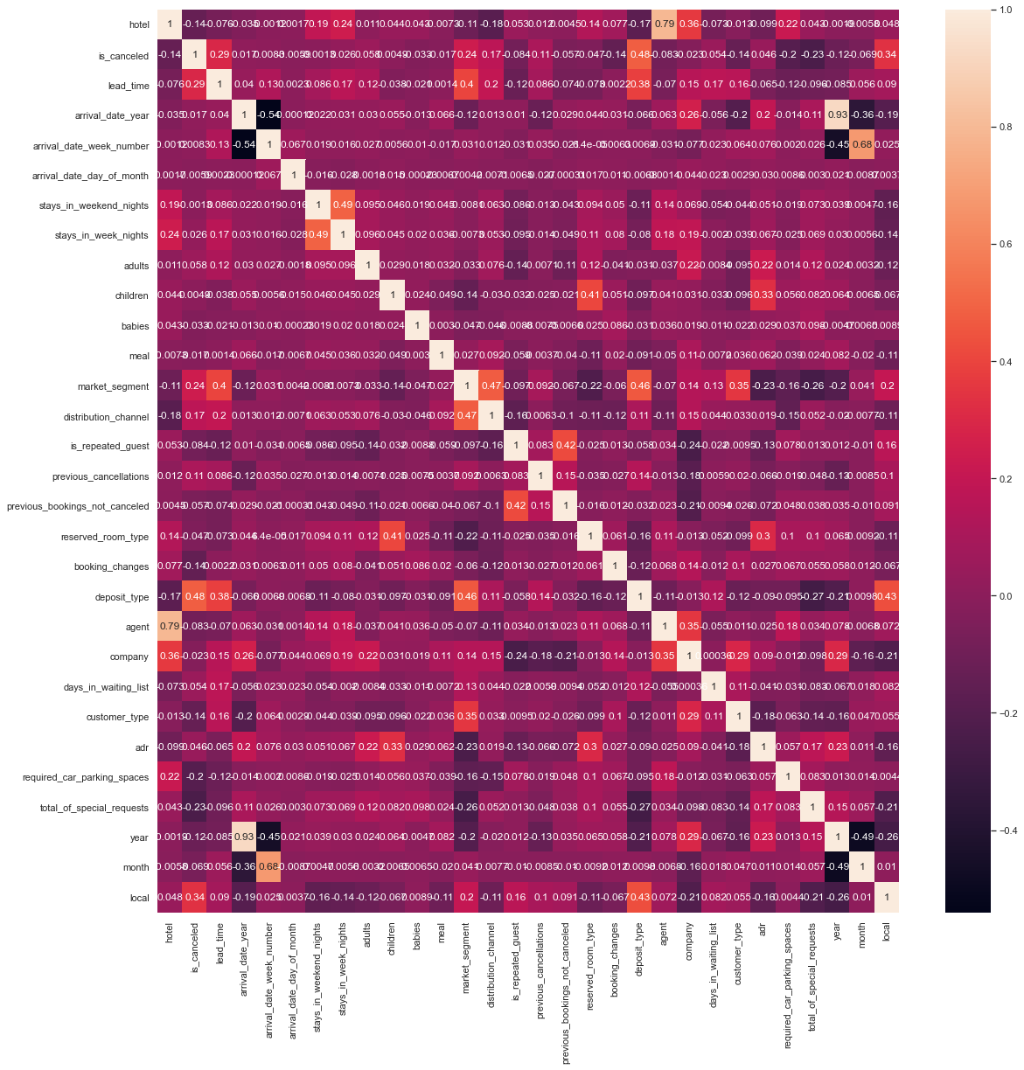
EDA
119390 Entries
Feature Data Types:
1 x Category
4 x float64
1 x int32
23 x int64
8 x object
Reservation Info:
Lead time, Reservation date, Booking length,
Weekday stay length, weekend stay length,
Deposit, parking spot request, room type, booking channel,
Room type, daily rate, total number of special requests, agent,
Number of booking changes, number of days in waiting list
Customer Info
Previous cancelations, previous booking without cancel, repeated customer, number of adults, number of children, number of infants, business or individual,
Hotel Info
City or Resort, meal, parking space, average daily rate

Slide 5
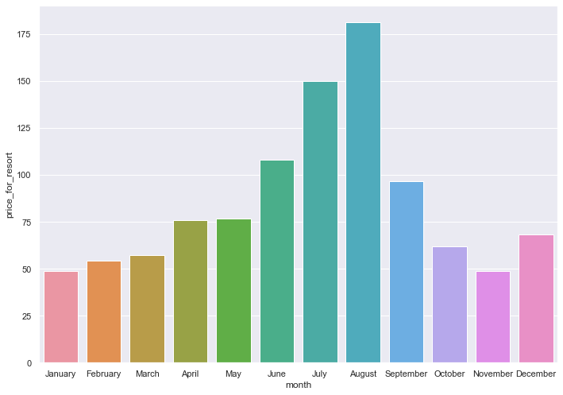
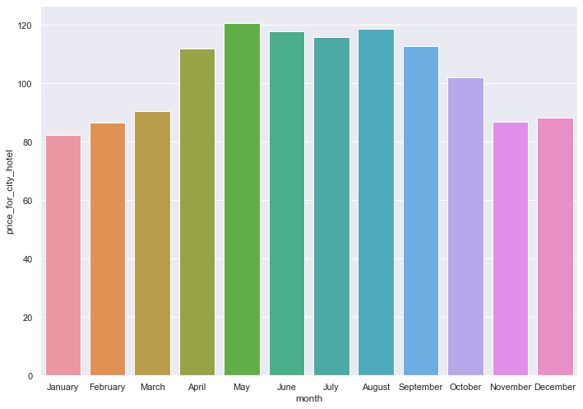
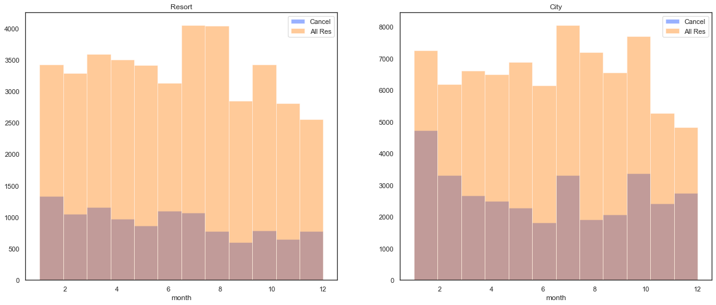
EDA

Slide 6
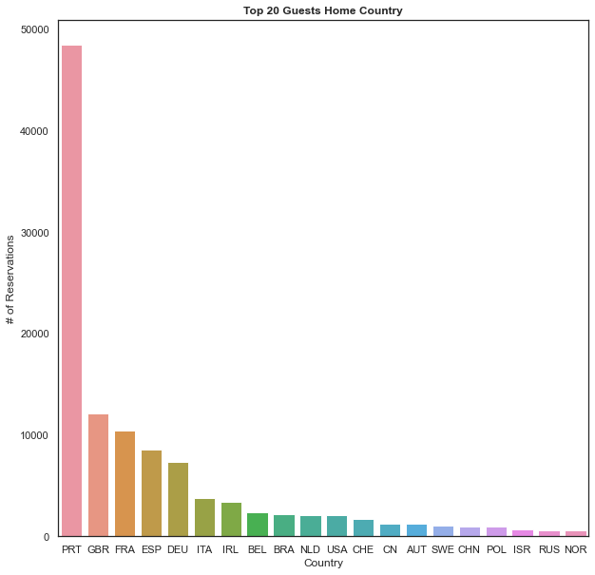
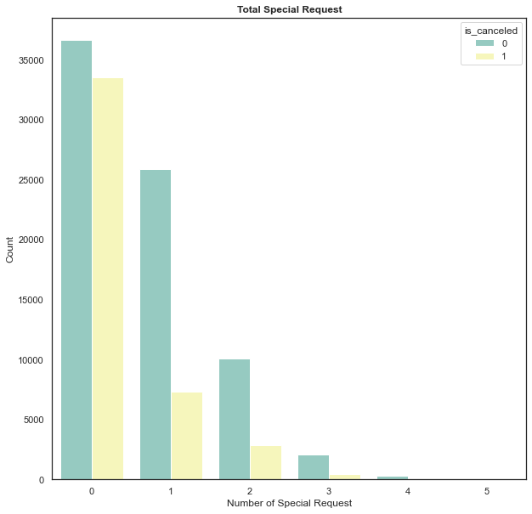
EDA

Slide 7
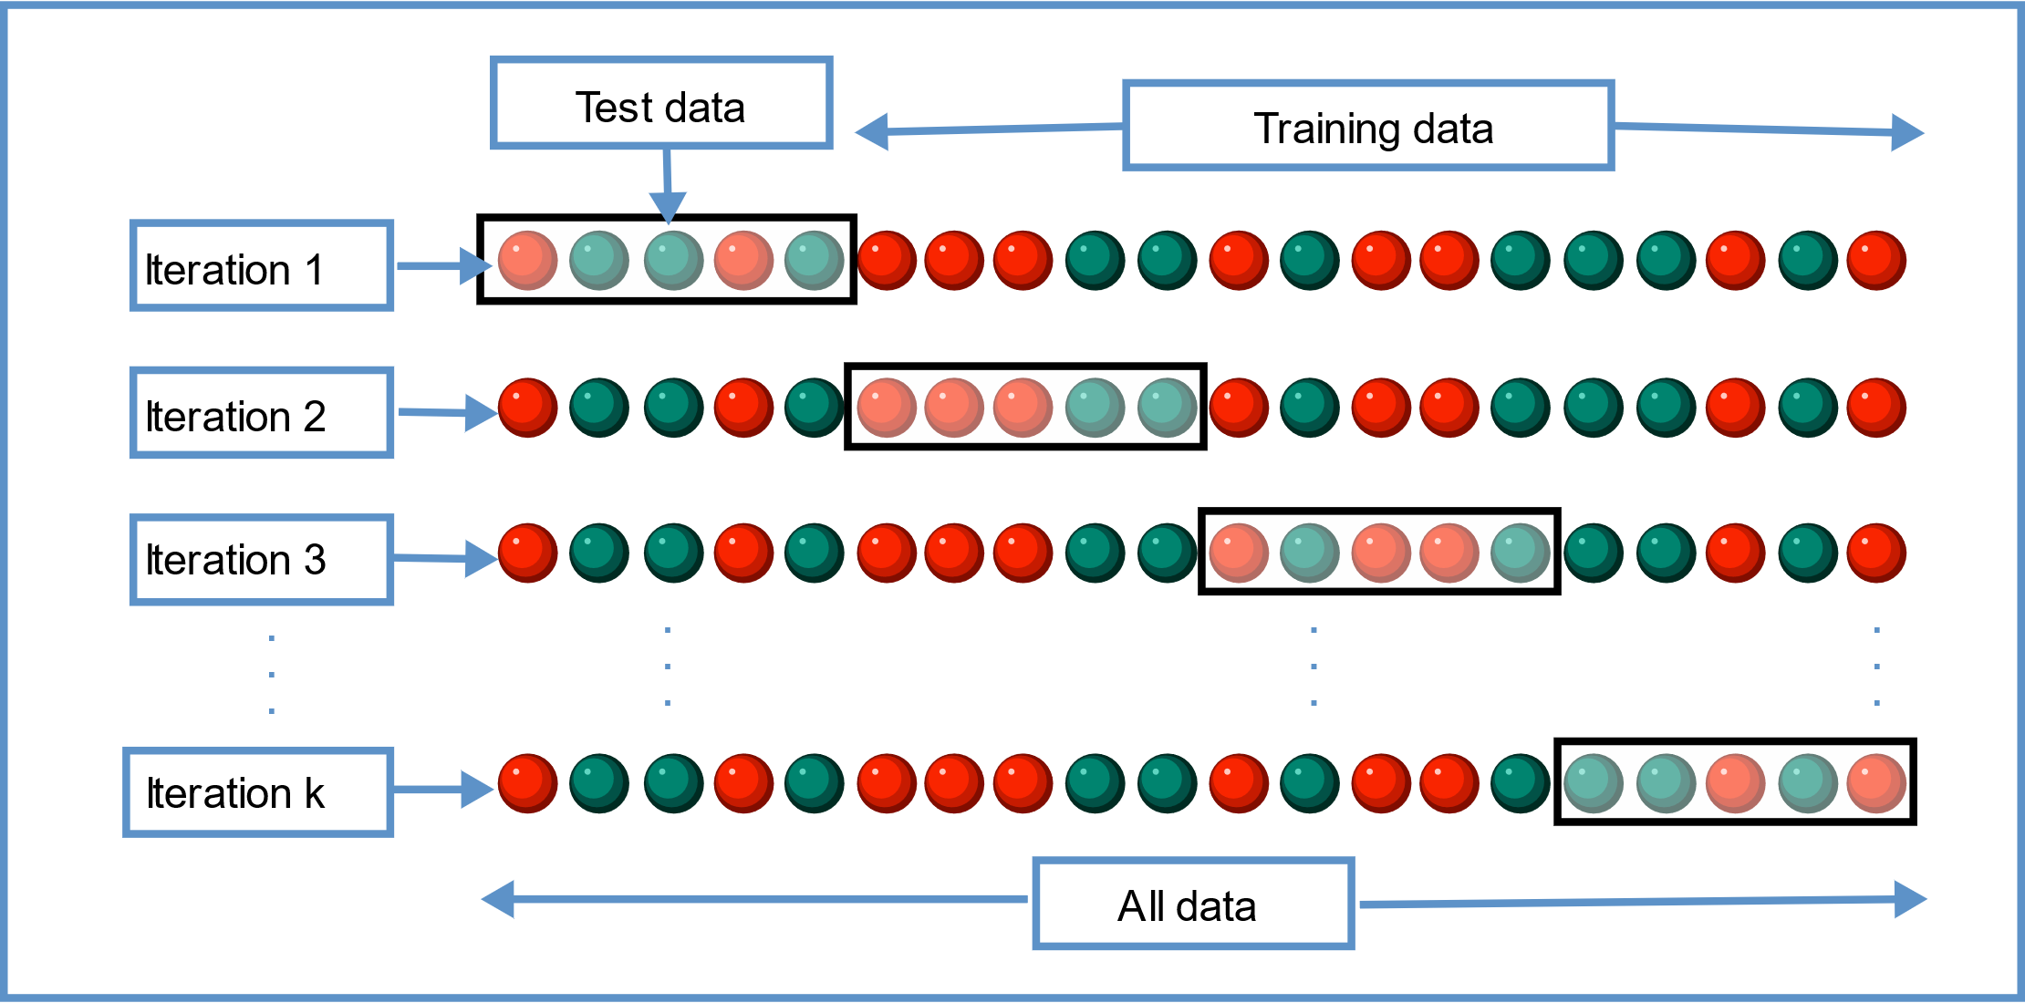
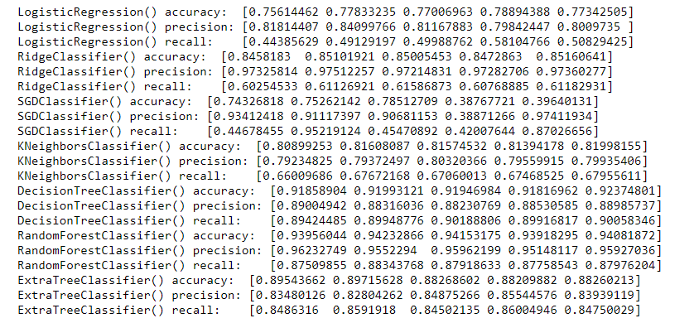
Model Selection with Cross Validation

Slide 8
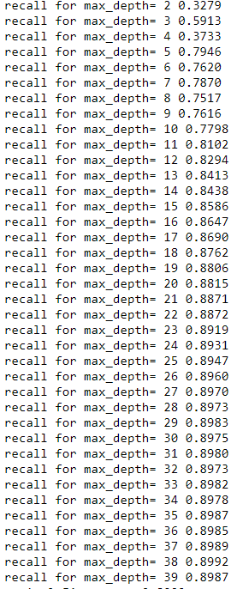
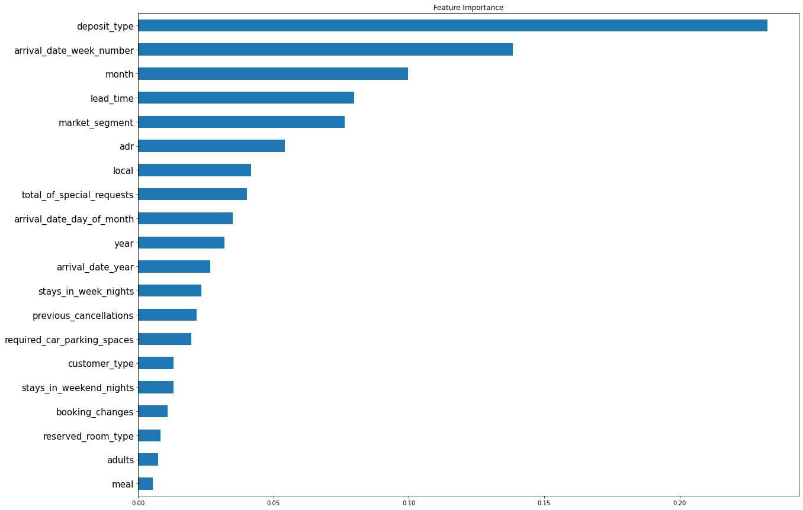
Optimize Decision Tree
All Data
DecisionTreeClassifier() accuracy: 0.920 [0.91779213 0.91997316 0.91909236 0.91846322 0.92328664]
DecisionTreeClassifier() precision:0.886 [0.89059522 0.88324421 0.88490399 0.88295053 0.88939154]
DecisionTreeClassifier() recall: 0.899 [0.8940196 0.90199203 0.9023376 0.89916817 0.8985242 ]
Resort type Hotel
DecisionTreeClassifier() accuracy: 0.921 [0.92846442 0.91822722 0.92421026 0.91909102 0.91497066]
DecisionTreeClassifier() precision:0.850 [0.85932722 0.85733573 0.85065502 0.84492689 0.8380035 ]
DecisionTreeClassifier() recall: : 0.866 [0.88124157 0.84738956 0.87567568 0.86857663 0.85873938]
City type Hotel
DecisionTreeClassifier() accuracy: 0.918 [0.91745089 0.92174572 0.91302975 0.91668772 0.91883527]
DecisionTreeClassifier() precision:0.895 [0.8968254 0.90344515 0.88404508 0.89929777 0.89347696]
DecisionTreeClassifier() recall: : 0.908 [0.91107458 0.9065534 0.9089525 0.90272782 0.91076876]

Slide 9
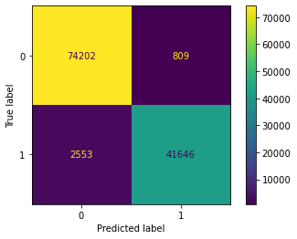
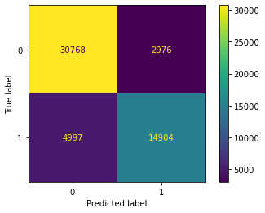
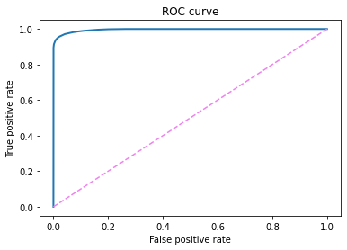
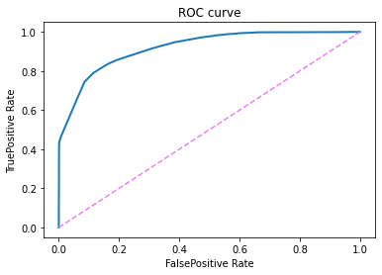
Decision Tree Results
model.fit(X,y)
model.fit(X_test,y_test) Test Data Size : %0.45

Slide 10

Future Work
A web application for hotel staff
Different models for different sessions
Different models for different personas

